Slide 1
Pi in the Sky
Take the Challenge
Have you ever celebrated Pi Day before? Why do we celebrate it on March 14th?

Slide 2
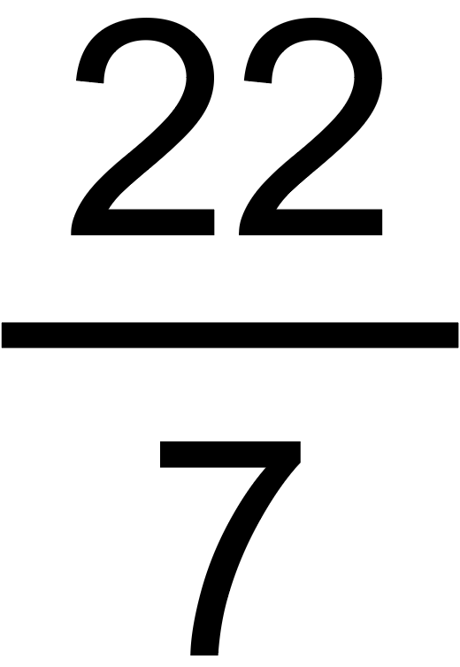
What is Pi?
Pi (written as the symbol π) has a value that is approximately equal to:
3.14
Now that you know the value of π, why do you think we celebrate Pi Day on March 14th?
I can also be approximated as
the improper fraction , or
the mixed number 3 .
Notes:
March is represented by the number “3” (third month of the year), and the “14” part of the decimal is used to represent the day of the month. So, the date 3/14 is assigned to be Pi Day because of pi’s value, 3.14.

Slide 3
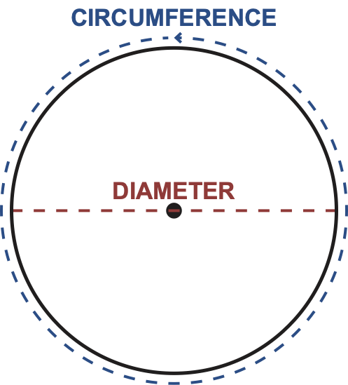
Diameter & Circumference
Before we learn more about π, let’s define some terms relating to circles.
The diameter of a circle is the distance across the widest part of the circle, which goes through the center of the circle.
The circumference of a circle is the distance around the circle.

Slide 4
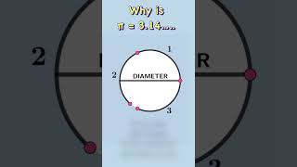
Where does 3.14 come from?
A circle’s circumference is equal to approximately the circle’s diameter, 3.14 times. This is true for all circles.

Slide 5
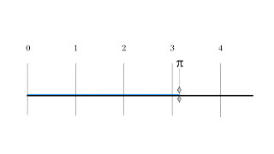
Where does 3.14 come from?
Another way to represent the value of π is the ratio of a circle’s circumference to its diameter. This is true for all circles.
π = 3.14 =
circumference
diameter

Slide 6
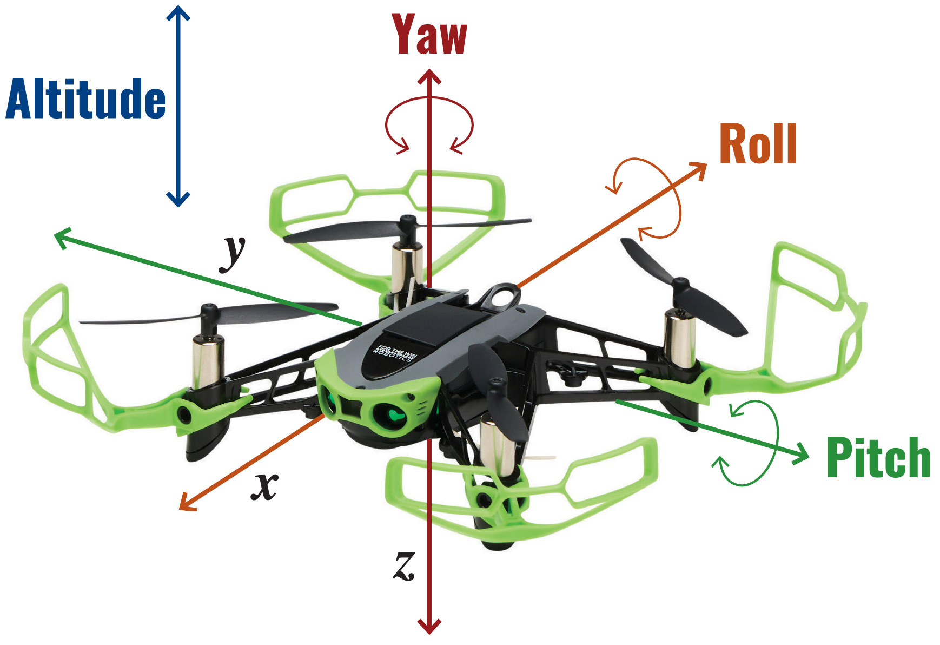
Flight Maneuvers – Altitude
The altitude is the height of Hopper above the ground while in flight.
As Hopper’s rotors increase in speed, the altitude increases.
As Hopper’s rotors decrease in speed, the altitude decreases.

Slide 7
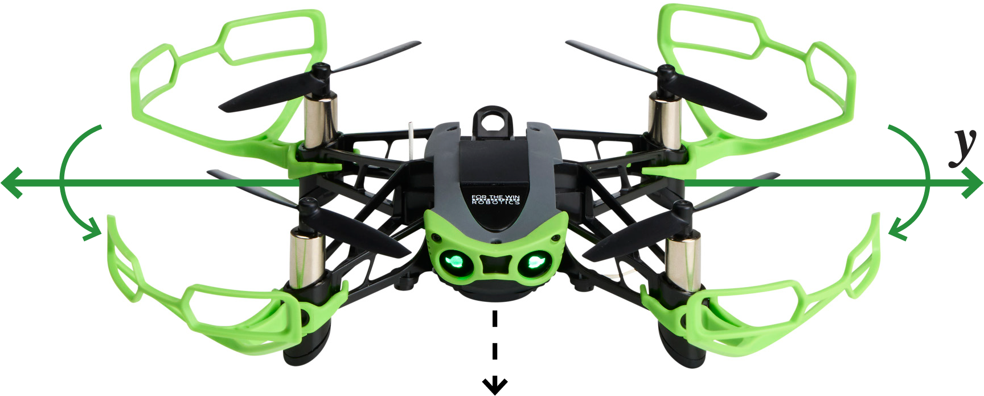
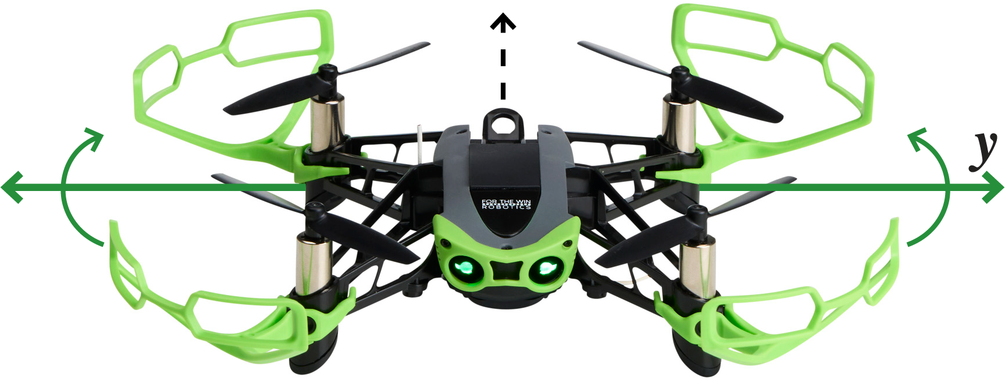
Flight Maneuvers – Pitch
Forward pitch occurs when Hopper’s front rotors spin slower than the rear rotors. Hopper moves forward.
Backward pitch occurs when Hopper’s front rotors spin faster than the rear rotors. Hopper moves backward.

Slide 8
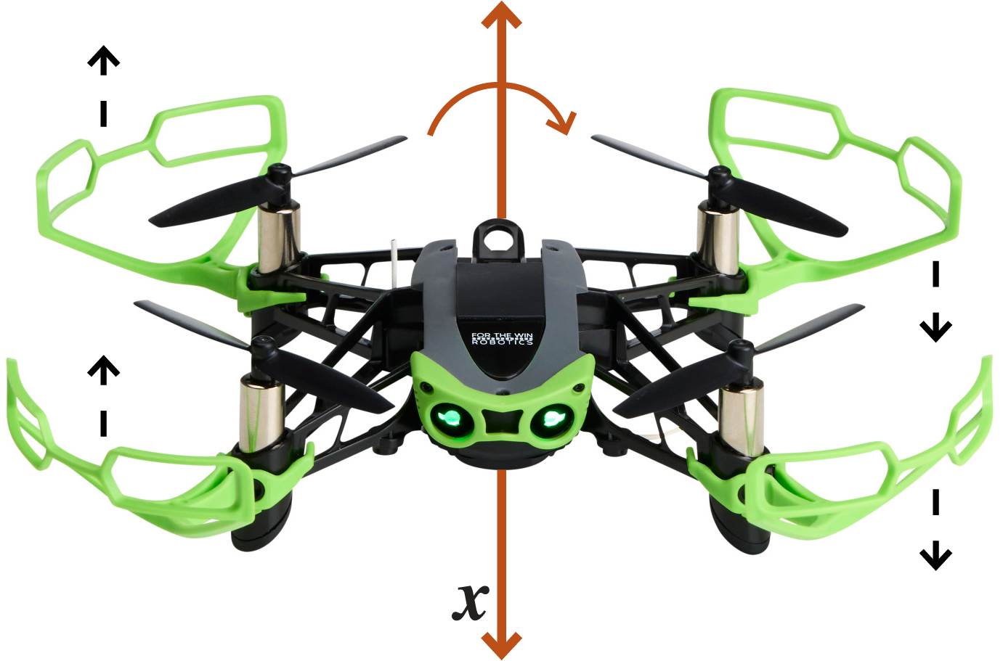
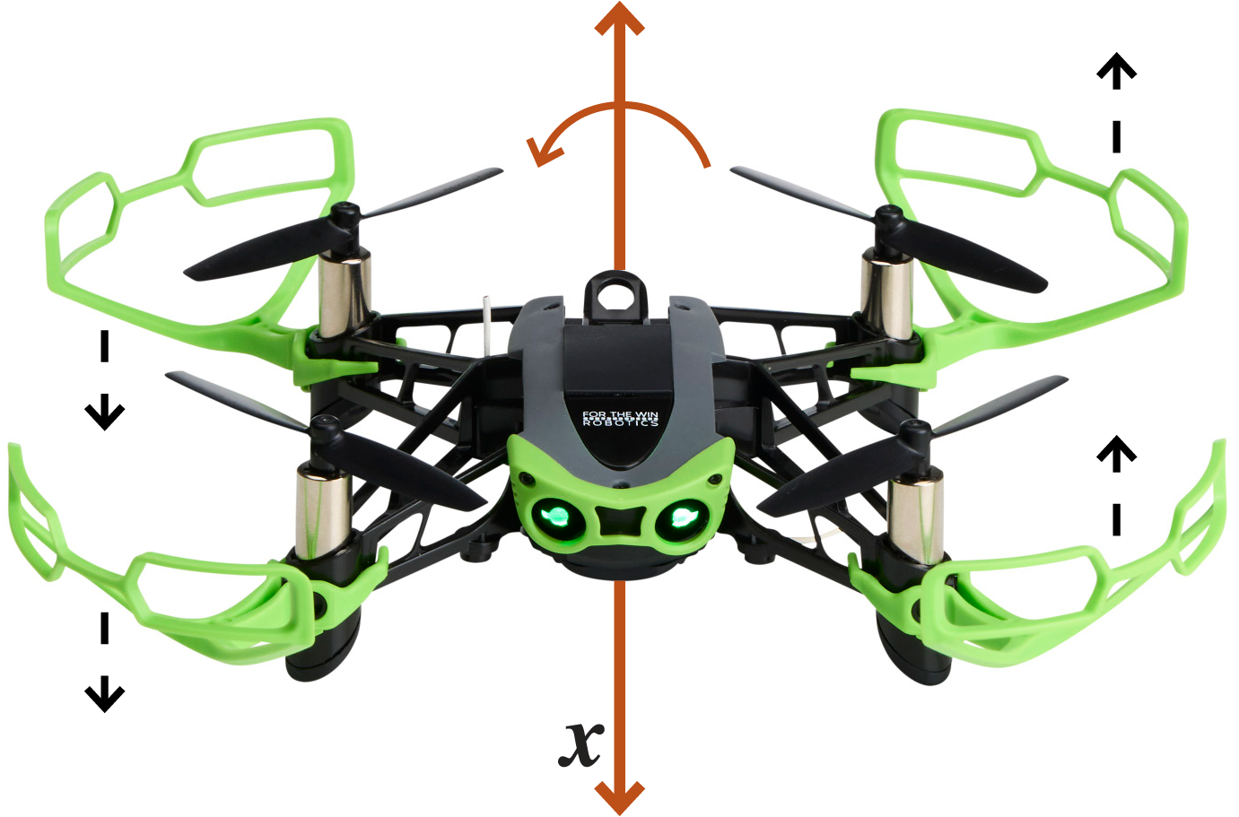
Flight Maneuvers – Roll
Roll left occurs when Hopper’s right rotors spin faster than the left rotors. Hopper moves to the left.
Roll right occurs when Hopper’s right rotors spin slower than the left rotors. Hopper moves to the right.

Slide 9
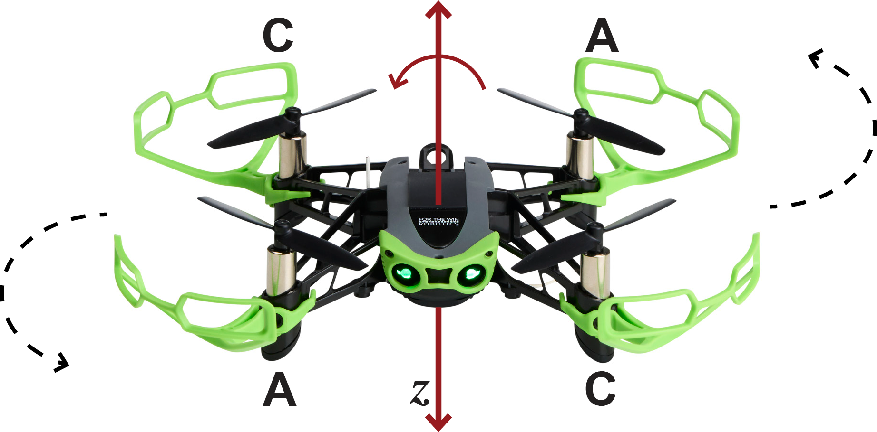
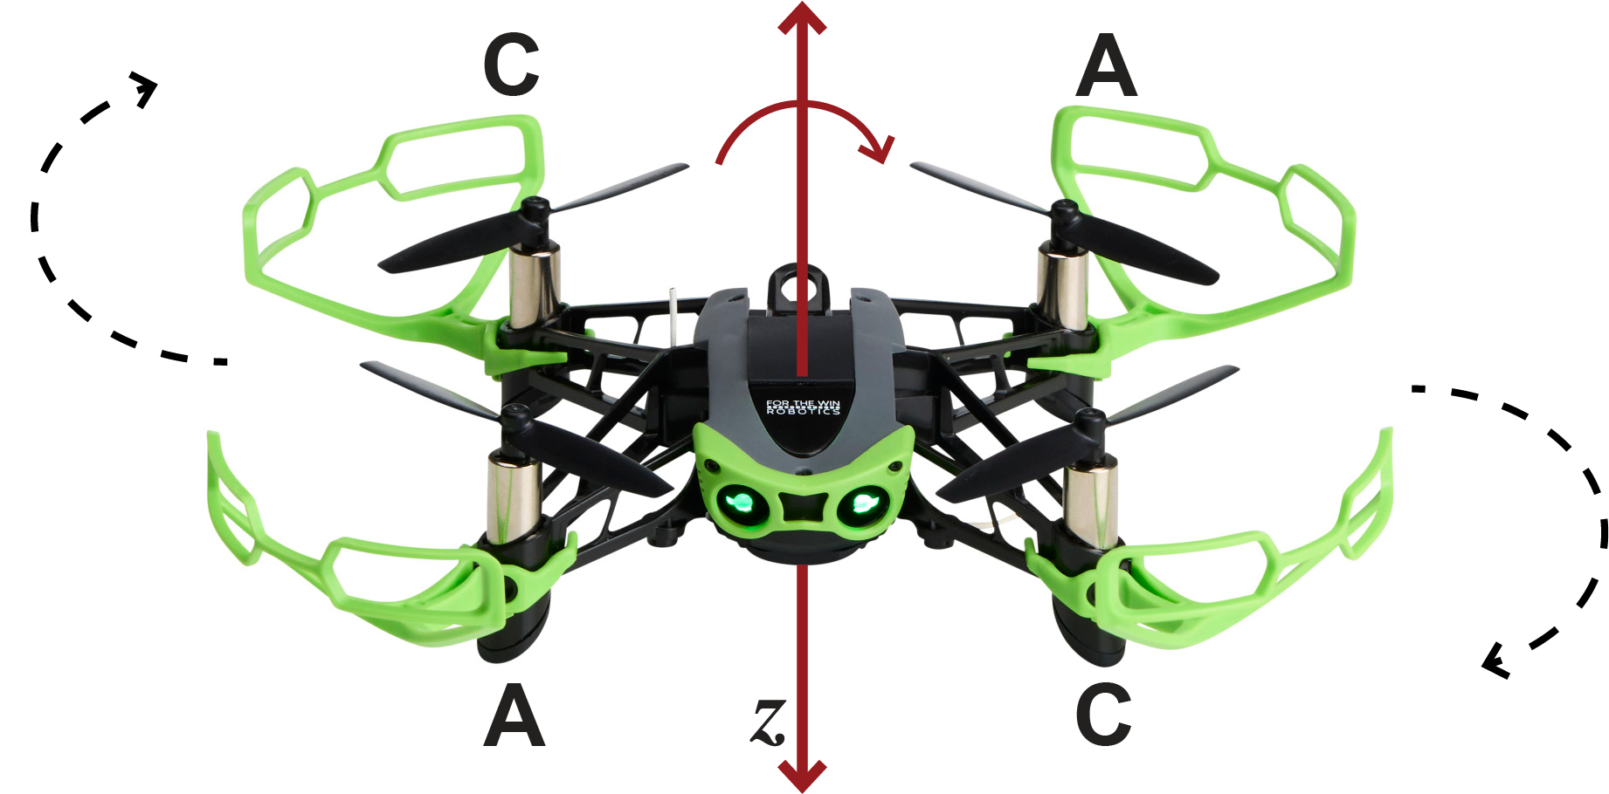
Flight Maneuvers – Yaw
Yaw left occurs when Hopper’s A (counterclockwise) rotors spin slower than the C (clockwise) rotors. Hopper rotates to the left.
Yaw right occurs when Hopper’s A (counterclockwise) rotors spin faster than the C (clockwise) rotors. Hopper rotates to the right.

Slide 10
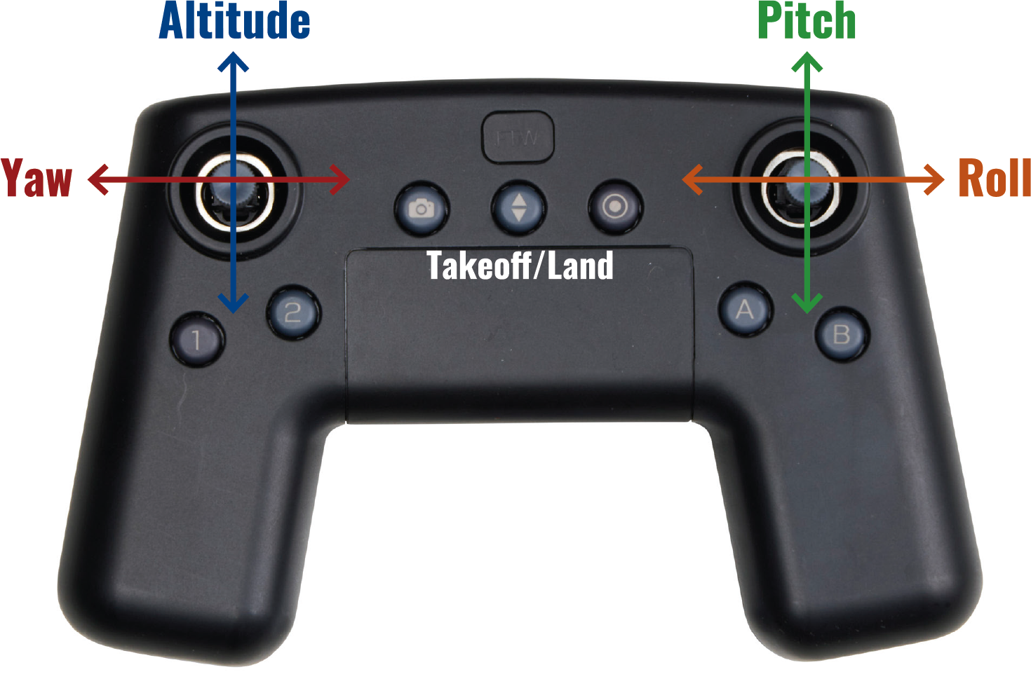
Flight Maneuvers – controller

Slide 11
Flying Hopper in a circle (1)
How can you pilot Hopper so that Hopper flies in a circle with eyes facing the same direction at all times?
How would you do this in a clockwise direction? How about a counterclockwise direction?
Which of the following maneuvers do you need to use?
Pitch
Roll
Yaw
Notes:
Using pitch and roll, move the right joystick in a clockwise/counterclockwise direction.
See the Pi Day 2025 Lesson Plan for visuals.

Slide 12
Flying Hopper in a circle (2)
How can you pilot Hopper so that Hopper flies in a circle with eyes facing the direction of flight at all times?
How would you do this in a clockwise direction? How about a counterclockwise direction?
Which of the following maneuvers do you need to use?
Pitch
Roll
Yaw
Notes:
Clockwise: Use yaw right and forward pitch.
Counterclockwise: Use yaw left and forward pitch.
See the Pi Day 2025 Lesson Plan for visuals.

Slide 13
Flying Hopper in a circle (3)
How can you pilot Hopper so that Hopper flies in a circle with eyes facing the center of the circle at all times?
How would you do this in a clockwise direction? How about a counterclockwise direction?
Which of the following maneuvers do you need to use?
Pitch
Roll
Yaw
Notes:
Clockwise: Use yaw right and roll left.
Counterclockwise: Use yaw left and roll right.
See the Pi Day 2025 Lesson Plan for visuals.
*The camera rotated at a 45 degree angle can be connected to a Wi-fi capable device for this flight. A tower placed at the center of the “circle” can be used to judge flight accuracy.

Slide 14
Post Lesson Discussion Questions
Did you learn anything new about π?
If you have celebrated Pi Day before, what did you do?
Which flight pattern was the easiest?
Which flight pattern was the most difficult?
Have you ever flown Hopper in a curved flight pattern before today?
How is flying Hopper in a circle different from flying Hopper in a straight line?
Notes:
*The questions on this slide can be adapted by the educator for the students as needed.

